Slide 1
Pray for
Methodist Theological School (MTS sibu)
June 2022

Slide 2
Pray that the board members, faculty, staff and students will remain focus
Motto: And we proclaim him, admonishing every man and teaching every man with all wisdom, that we may present every man complete in Christ. And for this purpose also , I labour, striving according to his power, which mightily works within me. (Colossians 1:28 – 29)
Mission: Spirit-empowered training for god’s people to be christ-like servant- leaders to proclaim Christ to the glory of god.
Vision: Strive to serve the church and the world by being a holistic training center.

Slide 3
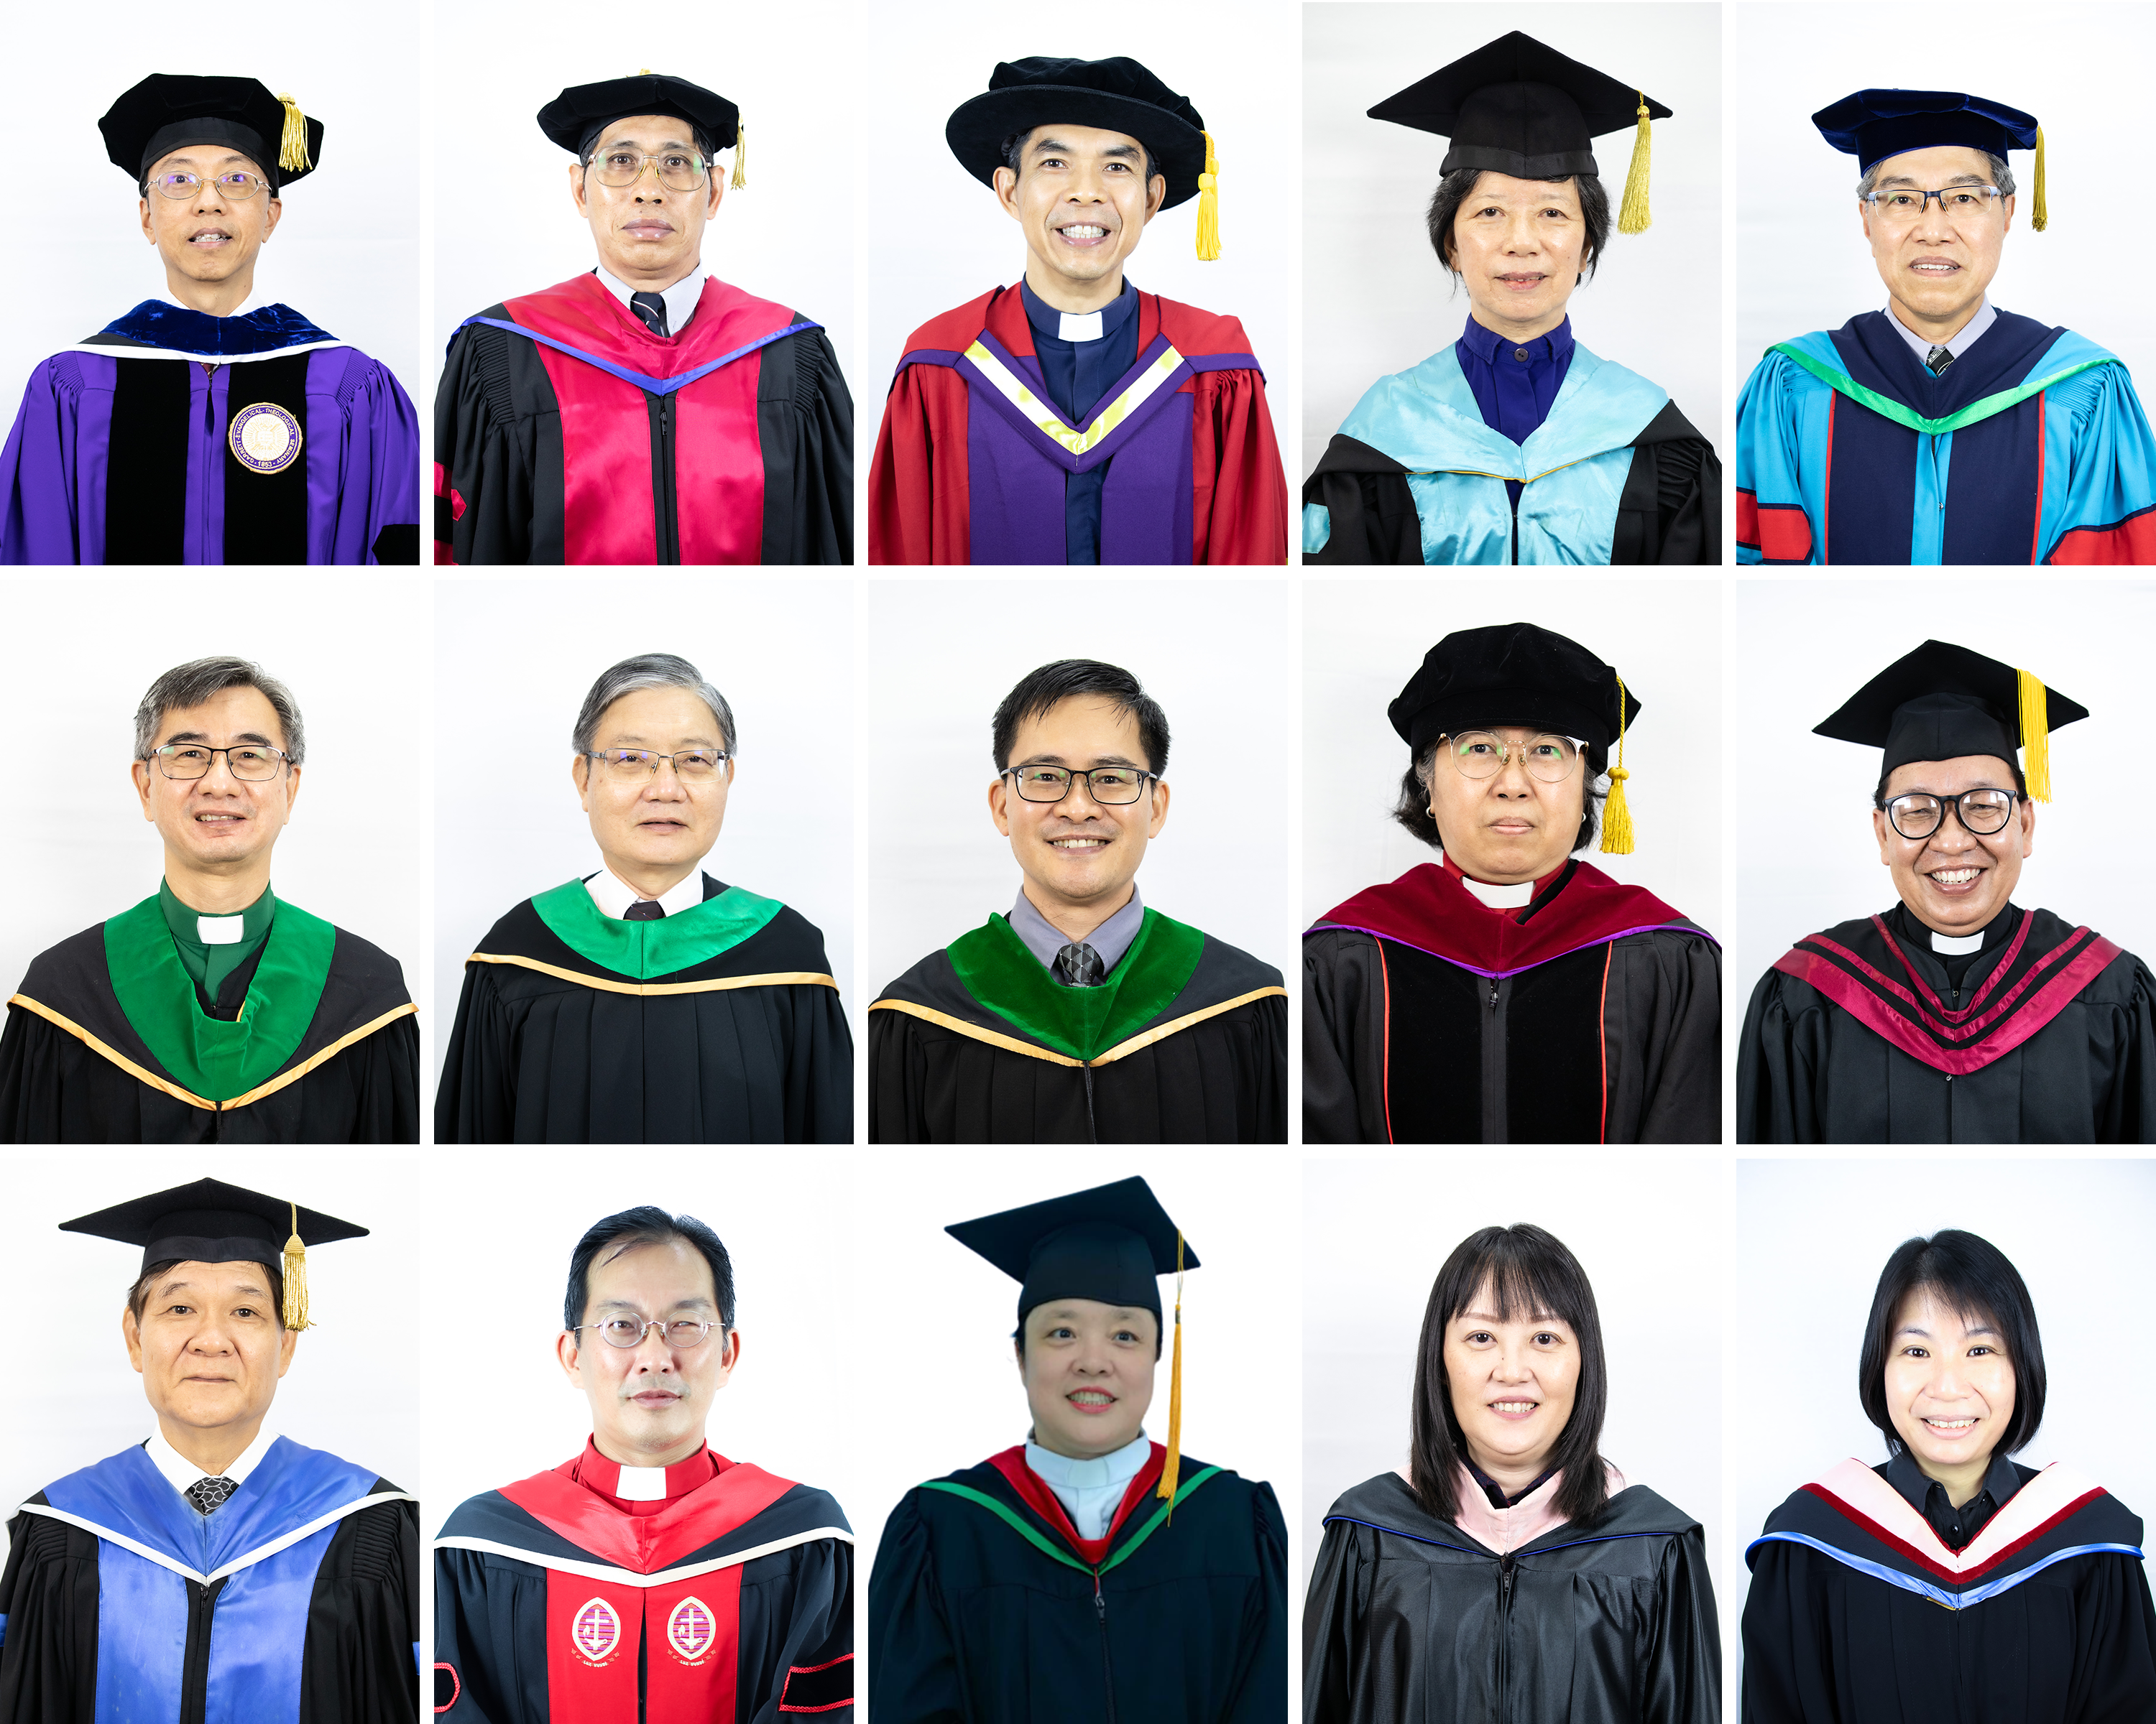
Pray for full time lecturers
Pray that all our 15 full-time lecturers will be strong and healthy physical and spiritually to teach with all wisdom and to minister with all passion.

Slide 4
Faculty in development
Give thanks & pray for strength and wisdom to accomplish….
Give thanks!
The final sprint!
Begin the journey
Rev Dr Lee ai sing Has completed her D. Min. (Spiritual direction) April, 2022.
6 Pastors Are qualified to be the supervisors for our clinical pastoral integration program
Rev ling tiong cheng Will finish his M.Th. (New testament) this September.
Rev lee shy yi Will complete her D. Th. (Christian education) next half of 2022
Pray for both to complete their dissertation writing & oral exams.
Rev. Jonathan lau Will be heading for trinity theological college, Singapore, for his M.Th. in new testament this June.

Slide 5
On job training
Remember these pastors who are going through their training while pastoring
Almost there
Continue to work hard
Continue to work hard
Rev sii hii tiong Will finish his d. Missiology dissertation and expected to graduate end of this year.
Rev daisy lau Is now writing his d. Min dissertation on pastoral studies
Rev. hoo sing hang & rev. dr. wong king sing Are both doing their Islamic studies at Pretoria university, South Africa.
Rev. candy liong Is studying @ STM for D. Min in spiritual direction
Rev wong tuong toh & rev tan sai hin Are both doing their D.Min course @ China Evangelical Theological Seminary, Taiwan
Rev Nicholas tan Is pursuing his M.Th. in new testament @ STM

Slide 6
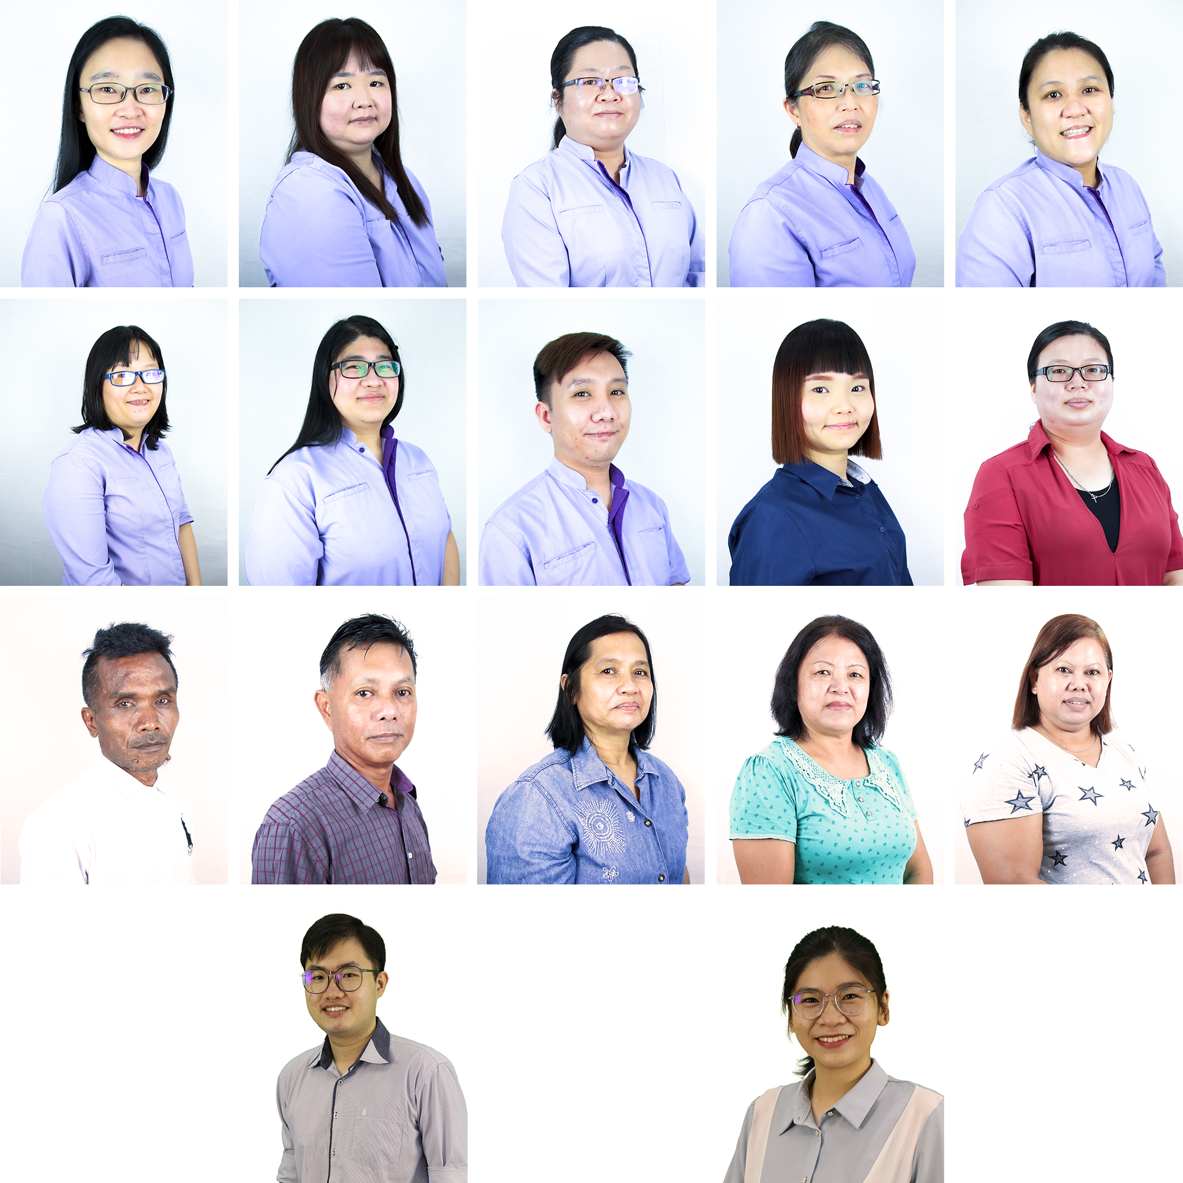
Pray for our staff
Intimacy with god
Dedicated,
patience
Efficient,
Humble
Joyful
As they serve the MTS community!

Slide 7
Remember our students……
1
4
Intimacy with god
Balanced lifestyle
Despite their busy schedule, they will seek to draw near god and continue to grow spiritually
Healthy diet & eating habit, disciplined daily exercises,
2
5
Calling from God
Coming silent retreat
They will hold on to God’s calling, be equipped to become servant leaders after god’s own heart.
They will be renewed & rejuvenated in their relationship with God and others in the coming silent retreat 20 – 21/6/2o22.
3
Learning in the Seminary
Diligent, ability to comprehend and apply what they have learnt

Slide 8
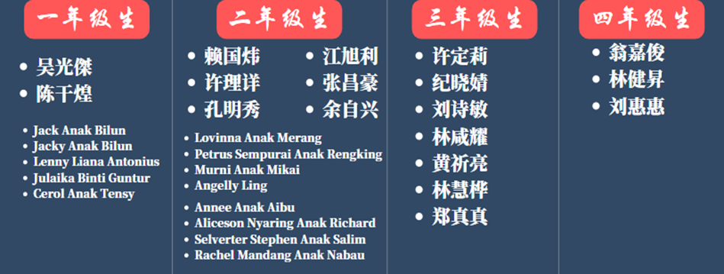

Second Year
First Year

Slide 9
Pray for new intake for 2023
Theological education for all the saints
God will raise up new pastors
Pray that god will raise up new generation of pastors from each district to be equipped in MTS
Pray that many lay persons will be willing to join theological education by extension designed to train and equip all our saints.
The harvest field are plentiful
Pray earnestly for those whom you knew who are called to full time ministry.

Slide 10



Pray for our short-term mission school in-progress 18/04/2022 – 11/07/2022
20 online MSTMS;
9 music & worship STMS； 11 BM STMS
Humiltiy and enthusiasm to learn
Pray for a week of short-term missions to different places (4- 10/07/2022)

Slide 11
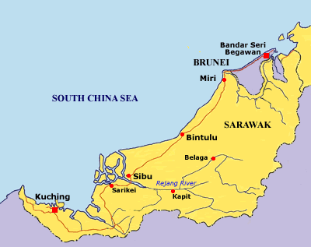
Pray for: Unity, Enthusiasm & Courage to evangelize, Effectiveness in our program, Spiritual Breakthrough, Readiness of the non-Christians to accept Christ
BM ministry @ Kanowit
Evangelism @ Chiew Cho, Bahagia, En Tao Methodist Church.
Sibu.
Digital Mission @ Limbang
Iban STMS students going to Kapit to evangelized
Evangelism @ Siburan & Serian Kuching.
BM Ministry @ Sarikei
San Yi, Ming Guang, Ming Yuan Methodist Church, Bintangor
Short-term Mission School Mission Awareness week reaching out to people in different corners of Sarawak 4 – 10/7/2022

Slide 12
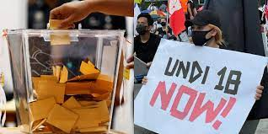



Public forum organized by the Wesleyan centre
Theme： UNDI 18: 年轻人，选择你的未来
Theme： UNDI 18: Pemuda, undilah masa depan kamu
22/07/2022
29/07/2022
Speaker：
Lawyer Ellah Lau
Rev. lau en hong
Speakers:
Lawyer Justin lau
Rev. Nicholas tan chung kiat

Slide 13
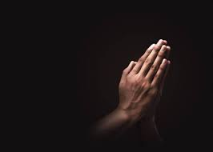

2 events organized by the Religion & culture Centre
Theme: Mengasihi kaum bumiputra
Theme: The practice of miring: biblbical perspective
Date: 25 – 26/6/2033
Speaker: Dr. Mark durie
Pray that this will bring spiritual awareness & freedom to many who are blinded by the teaching of the m-people in this land
Date: 23/07/2022
Speaker: Rev. Dennis gemang
Pray that Iban Christians and those who are reaching out to the Ibans will benefit from this seminar and to help many to be freed from the bondage & misconception of miring

Slide 14
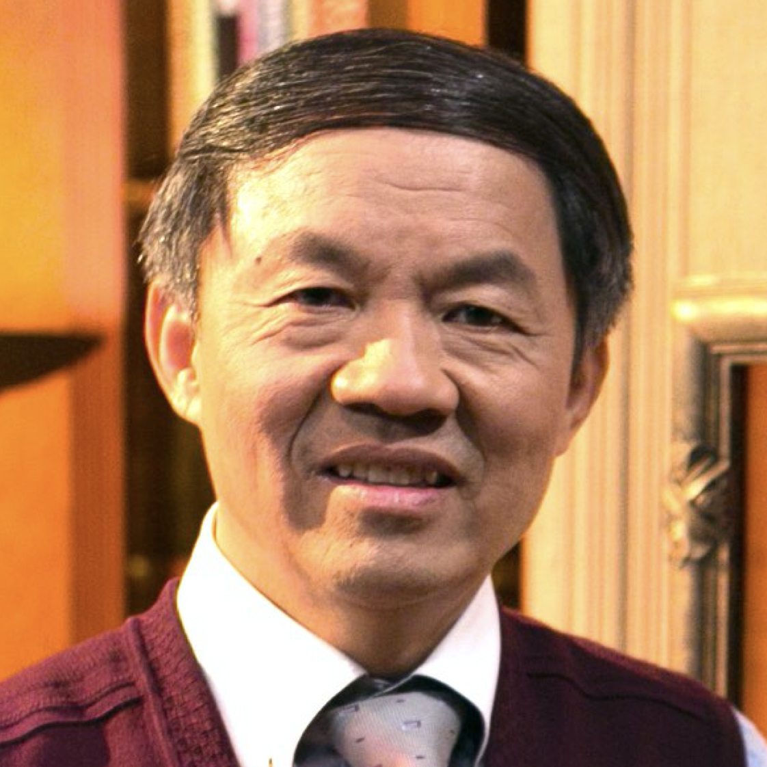
2 events for MTS night & dedication camp
MTS Night
Dedication Camp
$2B
Theme: 回应呼召， 忠心献上
FREEDOM TO INVENT
Date: 01/07/2022 7:30 pm
OnLINE
Date: 02/07/2022 8:00 – 11:00 am
Serviceable market
吴献章牧师

Slide 15
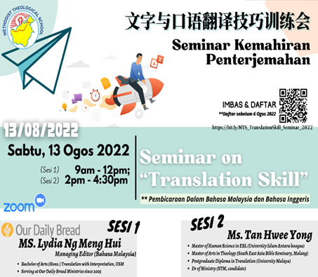
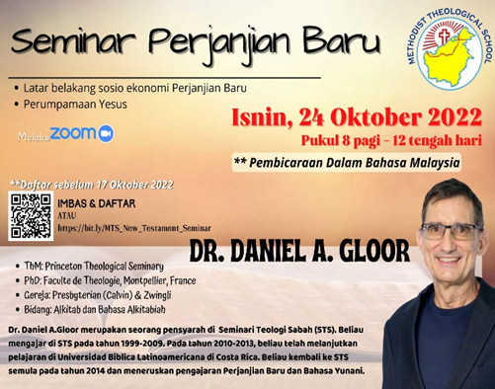
BM Seminars to equip everyone, Please pray

Slide 16

Jehovah jireh! Pray for financial needs.
2022 budget
Income, jan to april
Expenditure, jan. to april
Rm1,993.200.00
RM1,895,396.74
RM1,314,733.33

Slide 17
Glory be to god
God Bless You As You Remember Methodist Theological School (MTS Sibu) In Your Prayer

